Slide 1

WELCOME
Mobile Application Development

Slide 2

Fragment Life Cycle
Mobile Application Development
Lecture # 6
Instructor: Muhammad Naeem Khan

Slide 3
Fragment Life Cycle
The Fragment lifecycle in Android refers to the series of events that a Fragment goes through from its creation to its destruction. A Fragment's lifecycle is closely tied to its parent Activity's lifecycle. When a Fragment is created, it goes through several stages.
Including onAttach(), onCreate(), onCreateView(), onViewCreated(), onStart(), onResume(), onPause(), onStop(), onDestroyView(), onDestroy(), and onDetach().
These stages allow the Fragment to initialize its UI, bind to data, and respond to user interactions. As the Fragment's parent Activity goes through its own lifecycle stages, the Fragment's lifecycle is also affected, allowing it to adapt to changes in the Activity's state. Understanding the Fragment lifecycle is crucial for building robust and efficient Android apps.

Slide 4
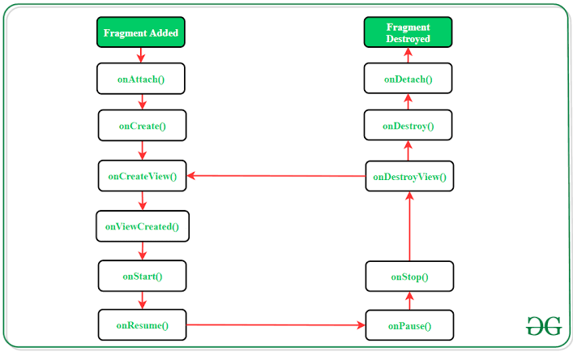
Fragment Life Cycle

Slide 5
Fragment Life Cycle Methods
onAttach(): Called when the Fragment is attached to its parent Activity.
onCreate(): Called when the Fragment is created.
onCreateView(): Called when the Fragment's view is created.
onViewCreated(): Called when the Fragment's view is created and the view's hierarchy is available.
onStart(): Called when the Fragment becomes visible.
onResume(): Called when the Fragment becomes active and is visible to the user.
onPause(): Called when the Fragment is paused and partially hidden.
onStop(): Called when the Fragment is stopped and completely hidden.
onDestroyView(): Called when the Fragment's view is destroyed.
onDestroy(): Called when the Fragment is destroyed.
onDetach(): Called when the Fragment is detached from its parent Activity.

Slide 6
Thank You

